Slide 1
SIMULINK
- Graphical extension to MATLAB for modeling and
simulation of systems

Slide 2
What is Simulink ?
Simulink is an environment for simulation and model-based design for dynamic and embedded systems.
It provides an interactive graphical environment and a customizable set of block libraries that let you design, simulate, implement, and test a variety of time-varying systems, including communications, controls, signal processing, and image processing.

Slide 3
Simulink offers…
A quick way of develop your model in contrast to text based-programming language such as e.g., C.
Simulink has integrated solvers. In text based-programming language such as e.g., C you need to write your own solver.

Slide 4

* In the MATLAB command window, at the >> prompt, type simulink and press  Enter * Click on Simulink Library icon or
How to Start...?

Slide 5
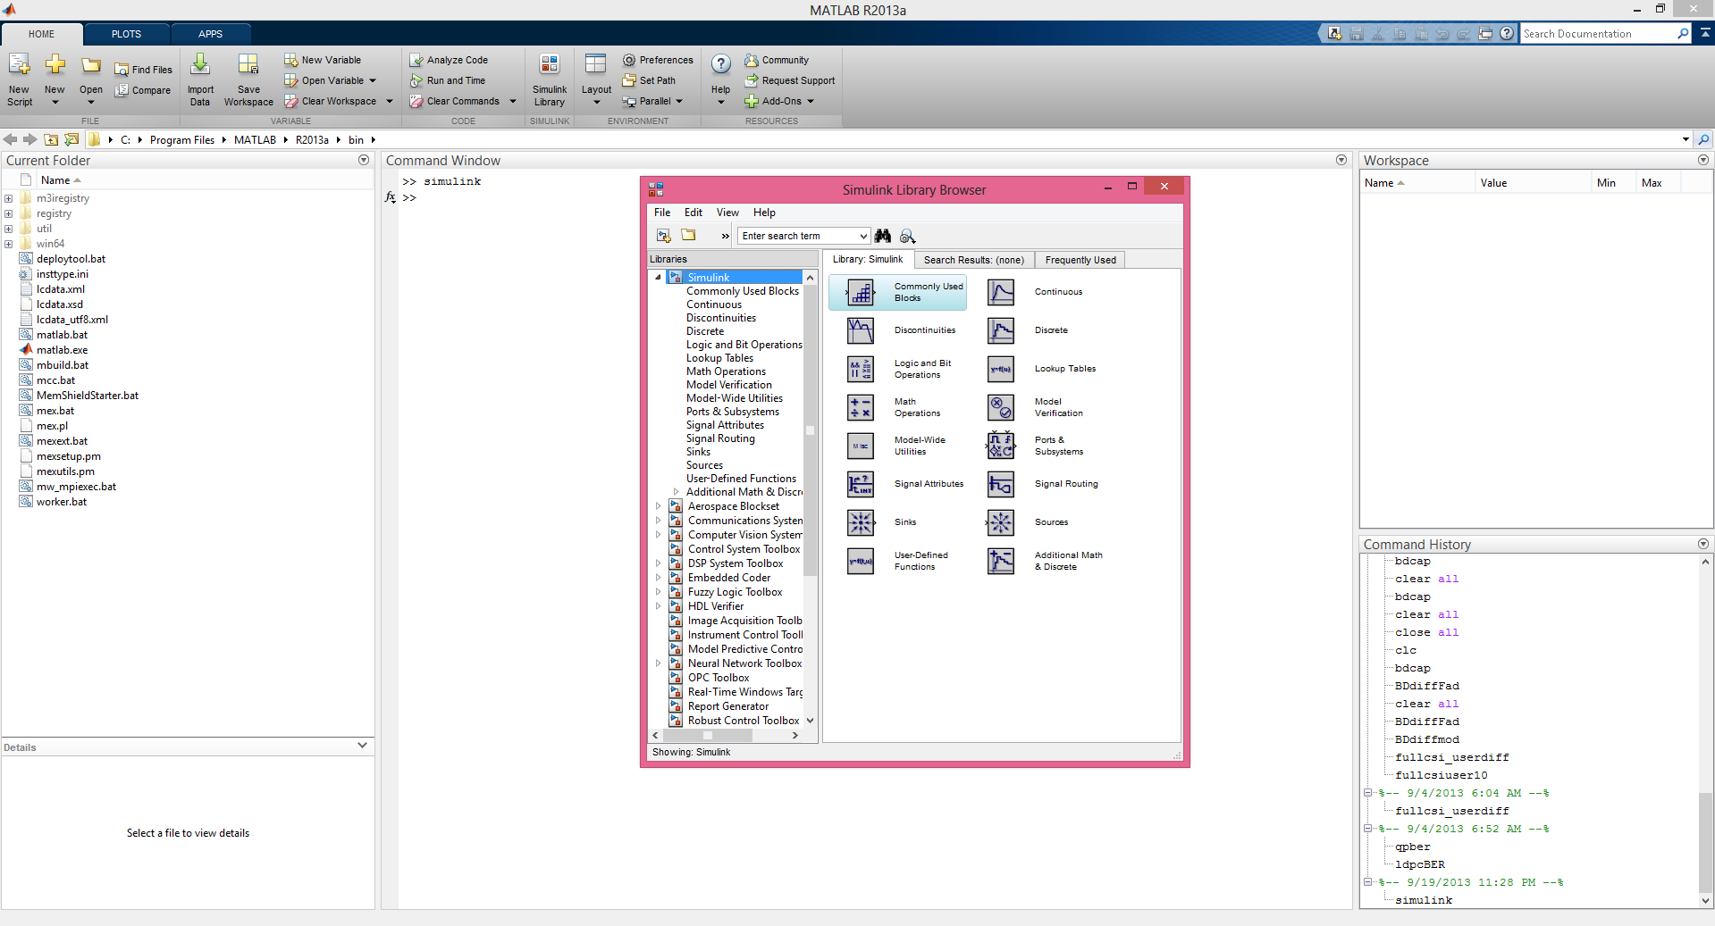

Slide 6
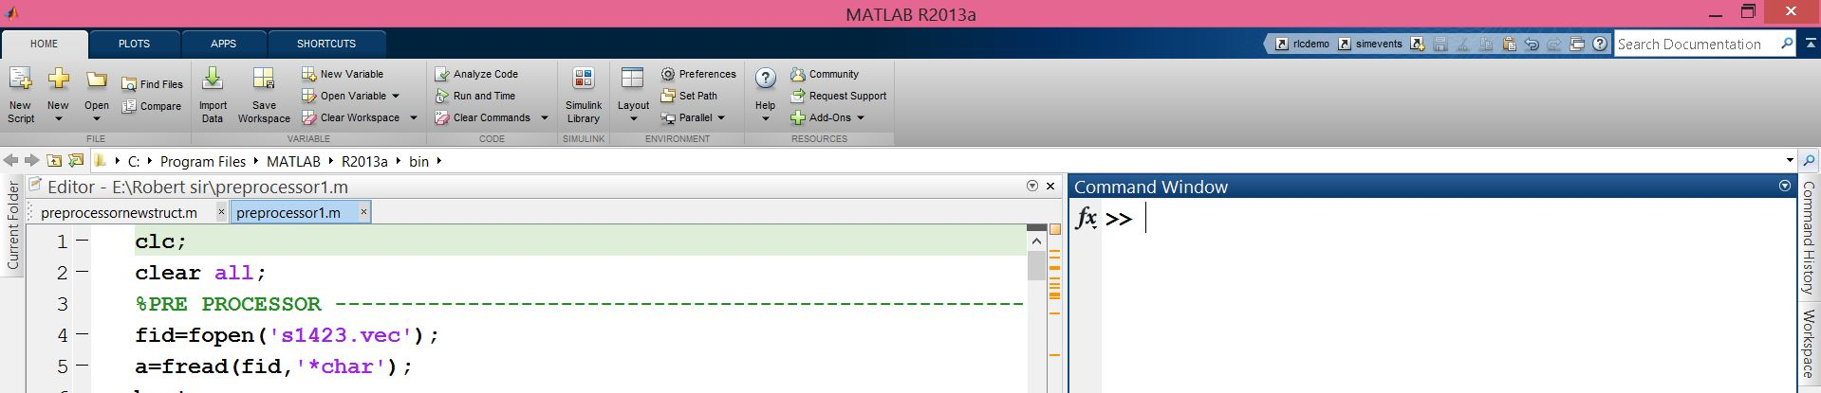
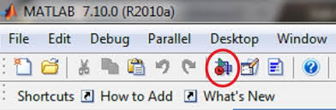

Slide 7
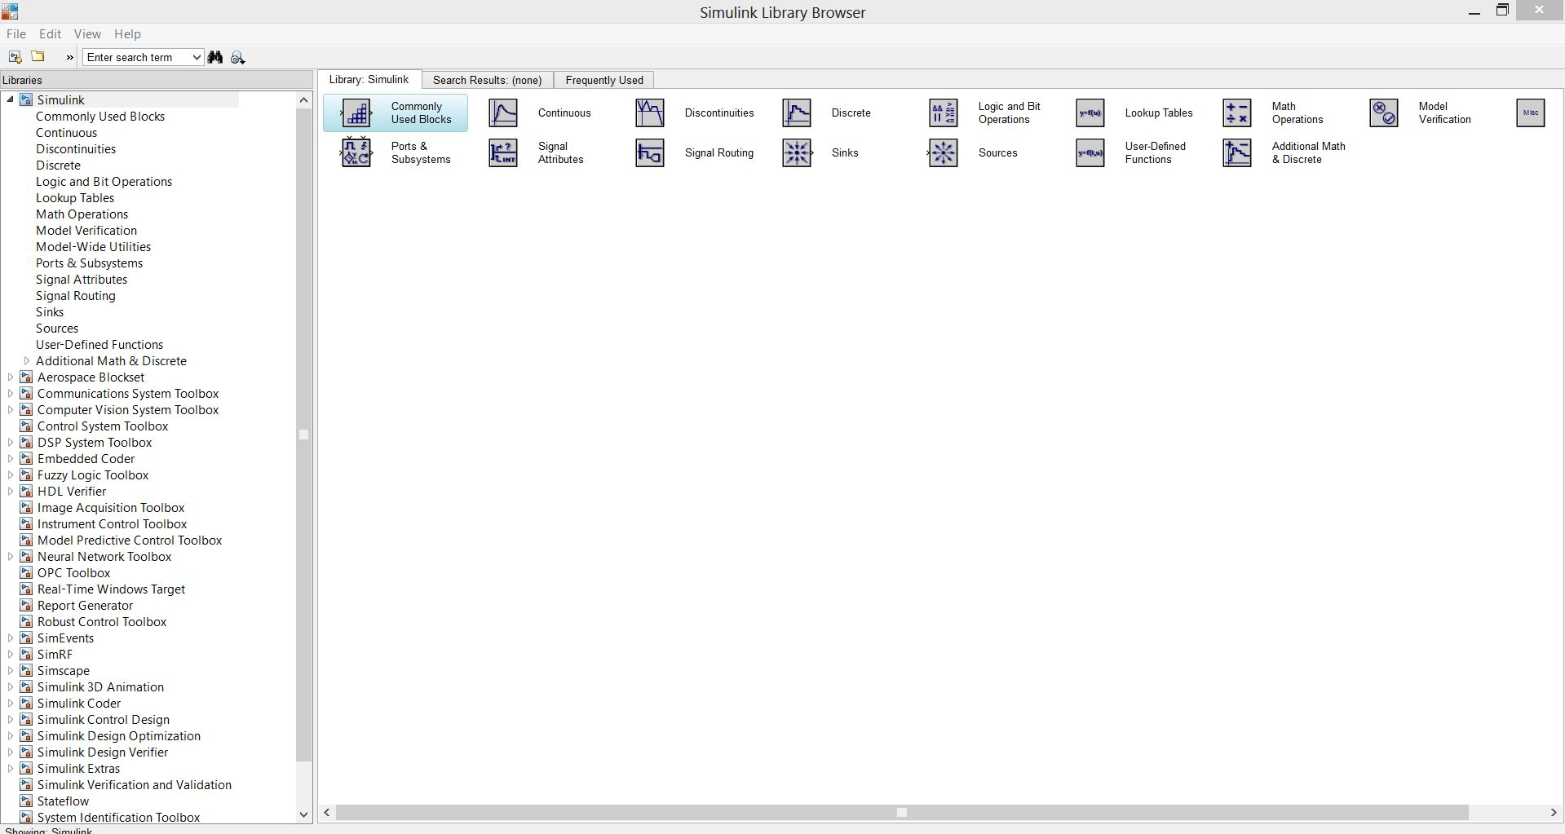
To open a new model
General Simulink Libraries
Block Sets
Blocks

Slide 8

Create New Model – Model Browser

Slide 9
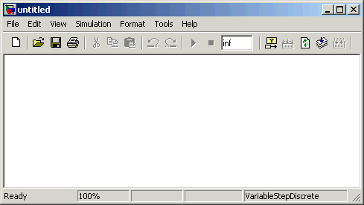
Opening a New Model Window
The first step in building a model is to open a new model window.
To do so, select New from the File menu, and then select Model. This opens an empty model window, as shown in the following figure.

Slide 10
Simulink Library Browser
The Simulink Library Browser is the library where you find all the blocks you may use in Simulink.
Simulink software includes an extensive library of functions commonly used in modeling a system.
Continuous and discrete dynamics blocks, such as Integration, Transfer functions, Transport Delay, etc.
Math blocks, such as Sum, Product, Add, etc
Sources, such as Ramp, Random Generator, Step, etc

Slide 11
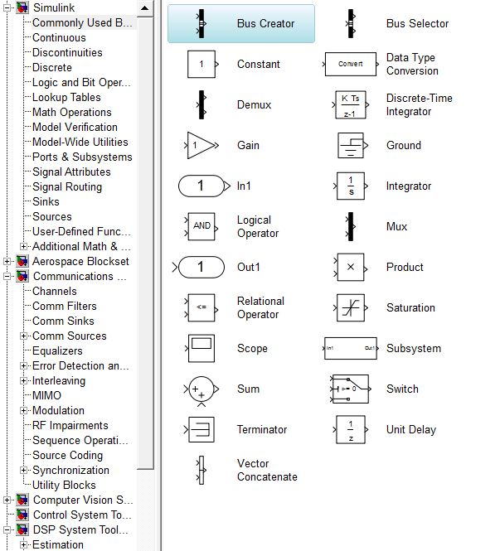
Commonly Used Blocks

Slide 12
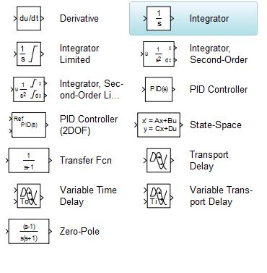
Continuous Blocks

Slide 13
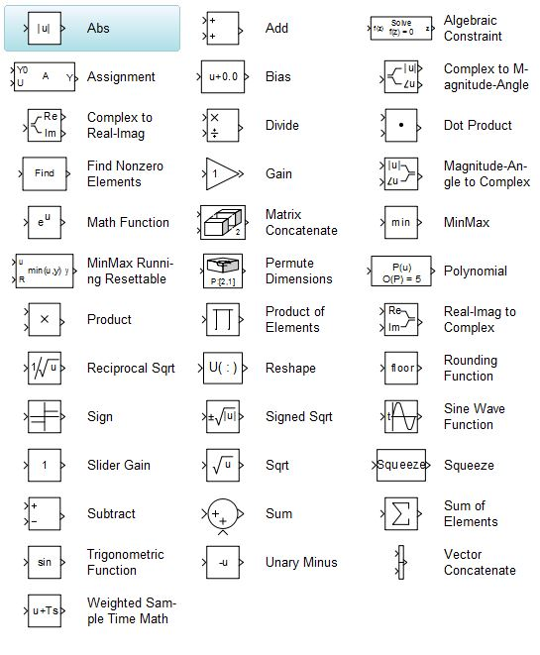
Mathematical Operations

Slide 14
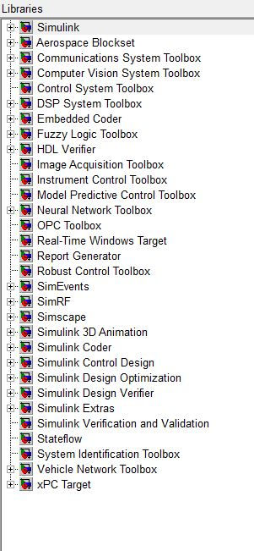
Toolboxes

Slide 15
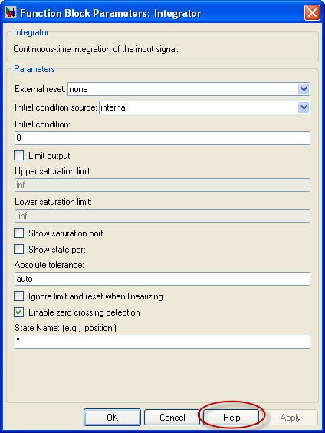
Help Window

Slide 16
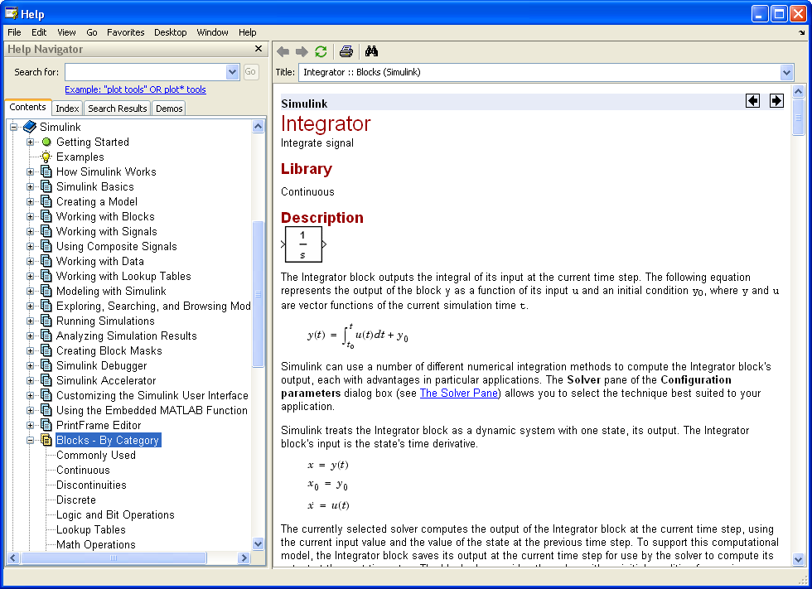
Help Window

Slide 17
Sources
Source Blocks are used to generate signals
Notice that all of the source blocks have a single output and no input

Slide 18
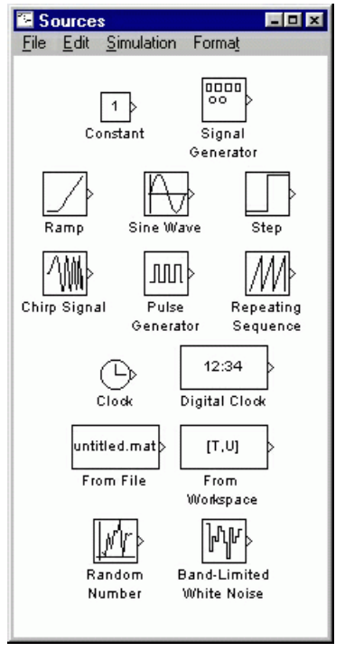
Constant
The Constant Source Block simply generates a constant signal
From File
The From File Source Block outputs a signal taken from a specified .mat file. A matrix saved in MATLAB as a .mat file will become a signal
From Workspace
Values are taken from workspace

Slide 19
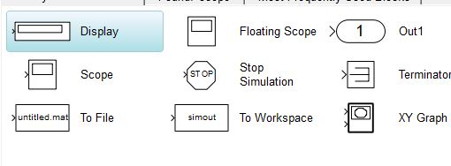
Sinks
Sink Blocks are used to display or output signals.
Notice that all of the sink blocks have inputs and no outputs. Most have a single input.

Slide 20
Sinks
Scope – Used to display outputs as function of time
To File –The To File Sink Block saves a signal to a .mat file in the same way that the From File Source Block reads from a file
XY graph - The XY Graph Sink Block plots one signal against another. It is useful for phase-plane plots, etc.
To Workspace - The To Workspace Sink Block stores a signal in a specified workspace variable. Unlike the To File Sink Block, the time is not saved in the variable, and must be stored separately.

Slide 21
Moving Blocks into the Model Window
Click the + sign next to DSP system Block set in the left pane of the Library Browser. This displays a list of the Signal Processing Block set libraries.
Click Sources in the left pane. This displays a list of the DSP Sources library blocks in the right pane. If you do not see the Sine Wave block, scroll down the list until it is visible.
Click the Sine Wave block and drag it into the model window.
Click DSP Sinks in the left pane of the Library Browser.
Scroll down in the right pane of the Library Browser until you see the Vector Scope block, and drag the block into the model window to the right of the Sine Wave block

Slide 22
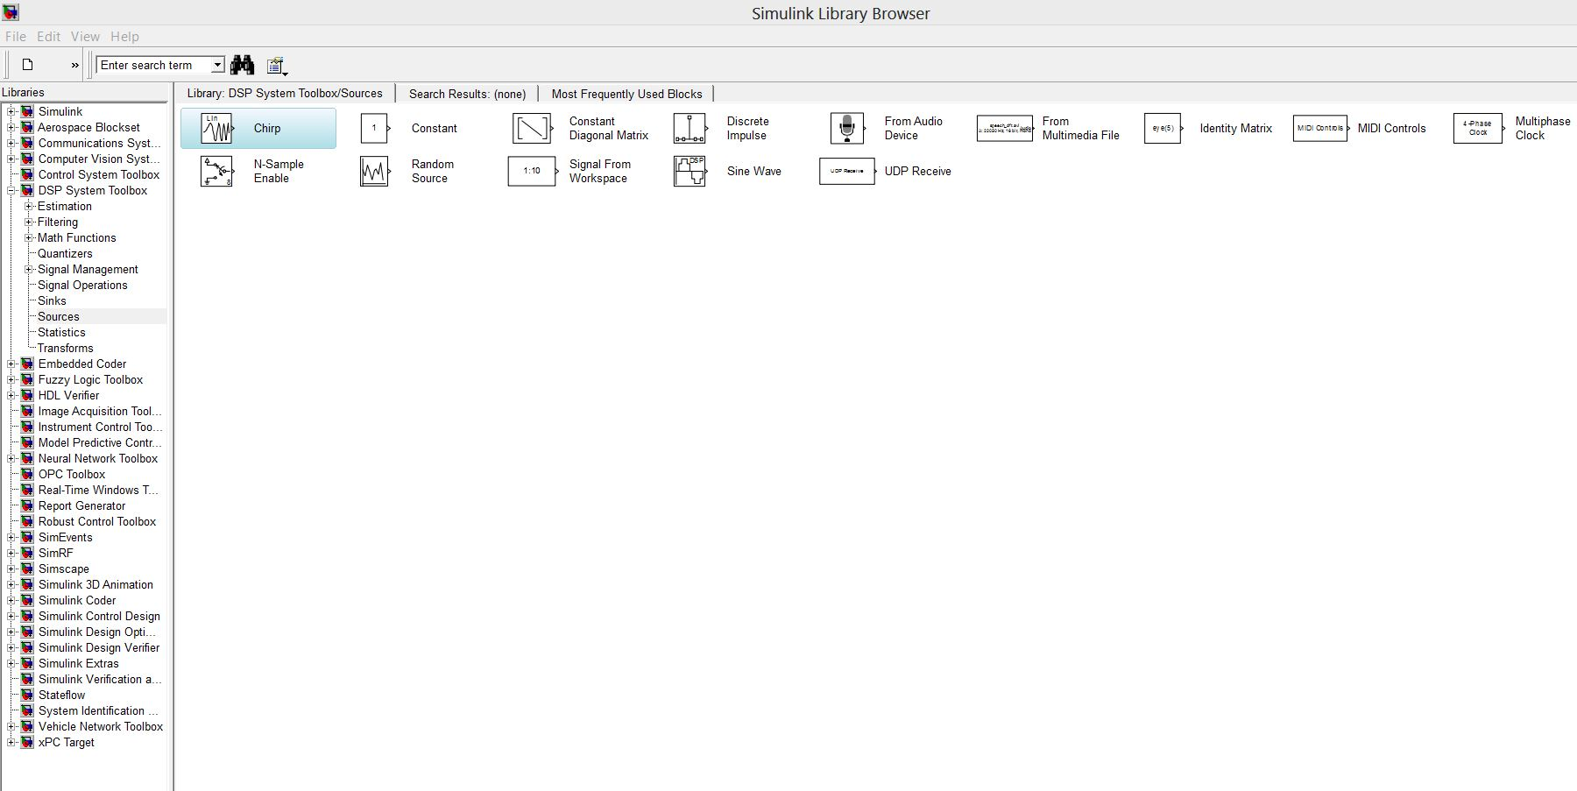

Slide 23
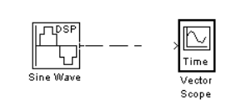
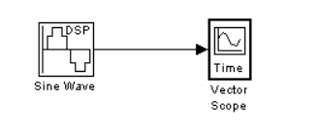

Connecting Blocks
The small arrowhead pointing outward from the right side of the Sine Wave block is an output port for the data the block generates. The arrowhead pointing inward on the Vector Scope block is an input port. To connect the two blocks, click the output port of the Sine Wave block and drag the mouse toward the input port of the Vector Scope block, as shown in the following figure.

Slide 24
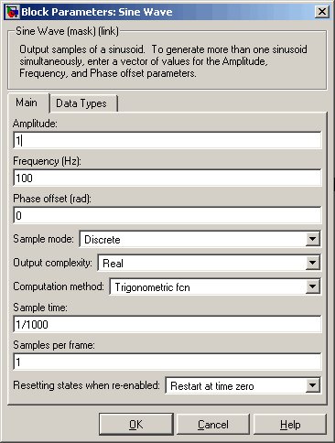
Setting Block Parameters – Sine wave
Set Amplitude to 5.
Set Frequency to 30.
Set Samples per frame to 100.
Click OK.
Note: You must set Samples per frame to a value larger than 1 to see an image of the sine wave in the Scope block

Slide 25
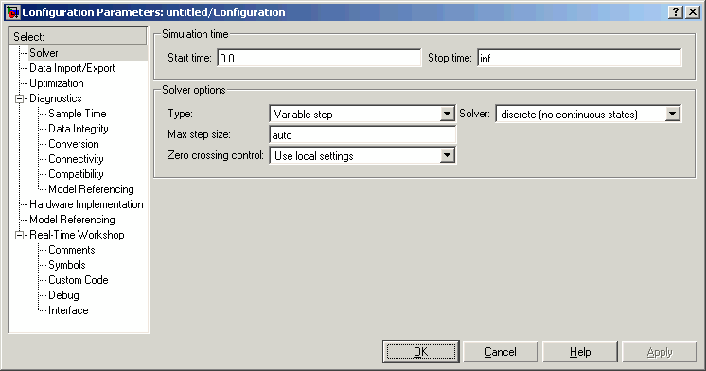
Setting Simulation Parameters
Select the Simulation menu at the top of the model window.
Select Configuration parameters to open the Configuration Parameters dialog box, as shown in the following figure.

Slide 26
Setting Simulation Parameters
Here you set important parameters such as:
Start and Stop time for the simulation
What kind of Solver to be used (ode45, ode23 etc.)
Fixed-step/Variable-step
Solvers are numerical integration algorithms that compute the system dynamics over time using information contained in the model.
Simulink provides solvers to support the simulation of a broad range of systems, including continuous-time (analog), discrete-time (digital), hybrid (mixed-signal), and multi rate systems of any size.

Slide 27
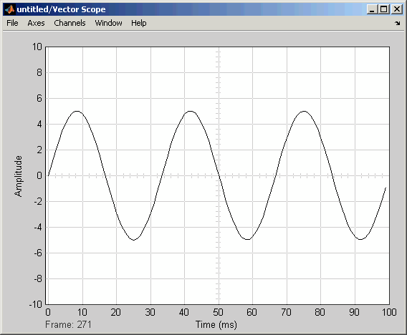
Running the Model
Run the model by selecting Start from the Simulation menu. When you do so,
A scope window appears, displaying a sine wave.

Slide 28
Q:1
In which library you can find sum of elements block
Ans: Math operations

Slide 29
Q: 2
Following are steps to automatically connect blocks
Click and select the source block
Press and hold _____ key
Click and select the destination block
Ans: Ctrl Key

Slide 30
Q:3
You can specify MATLAB workspace variables used as inputs and outputs to a Simulink model from which menu item
A. File -> Model properties
B. Simulation->Model configuration parameters->solver
C. Simulation->Model configuration parameters->data import/export
D. None of the above
Ans: A,B,C

Slide 31
Example :1 - Integrator

Slide 32
Example :1 - Integrator
What type of solver can be used for integrator ?
Two give limits change in integrator block initial condition source in -> external
Replace constant with sine wave and see the result

Slide 33
Example :2 - Integrator + Gain block

Slide 34
Example :2 - Integrator + Gain block
Try giving gain values as 3:1:10
Saturation Values
Upper limit rand(8,1)*10
Lower limit rand(8,1).*10

Slide 35
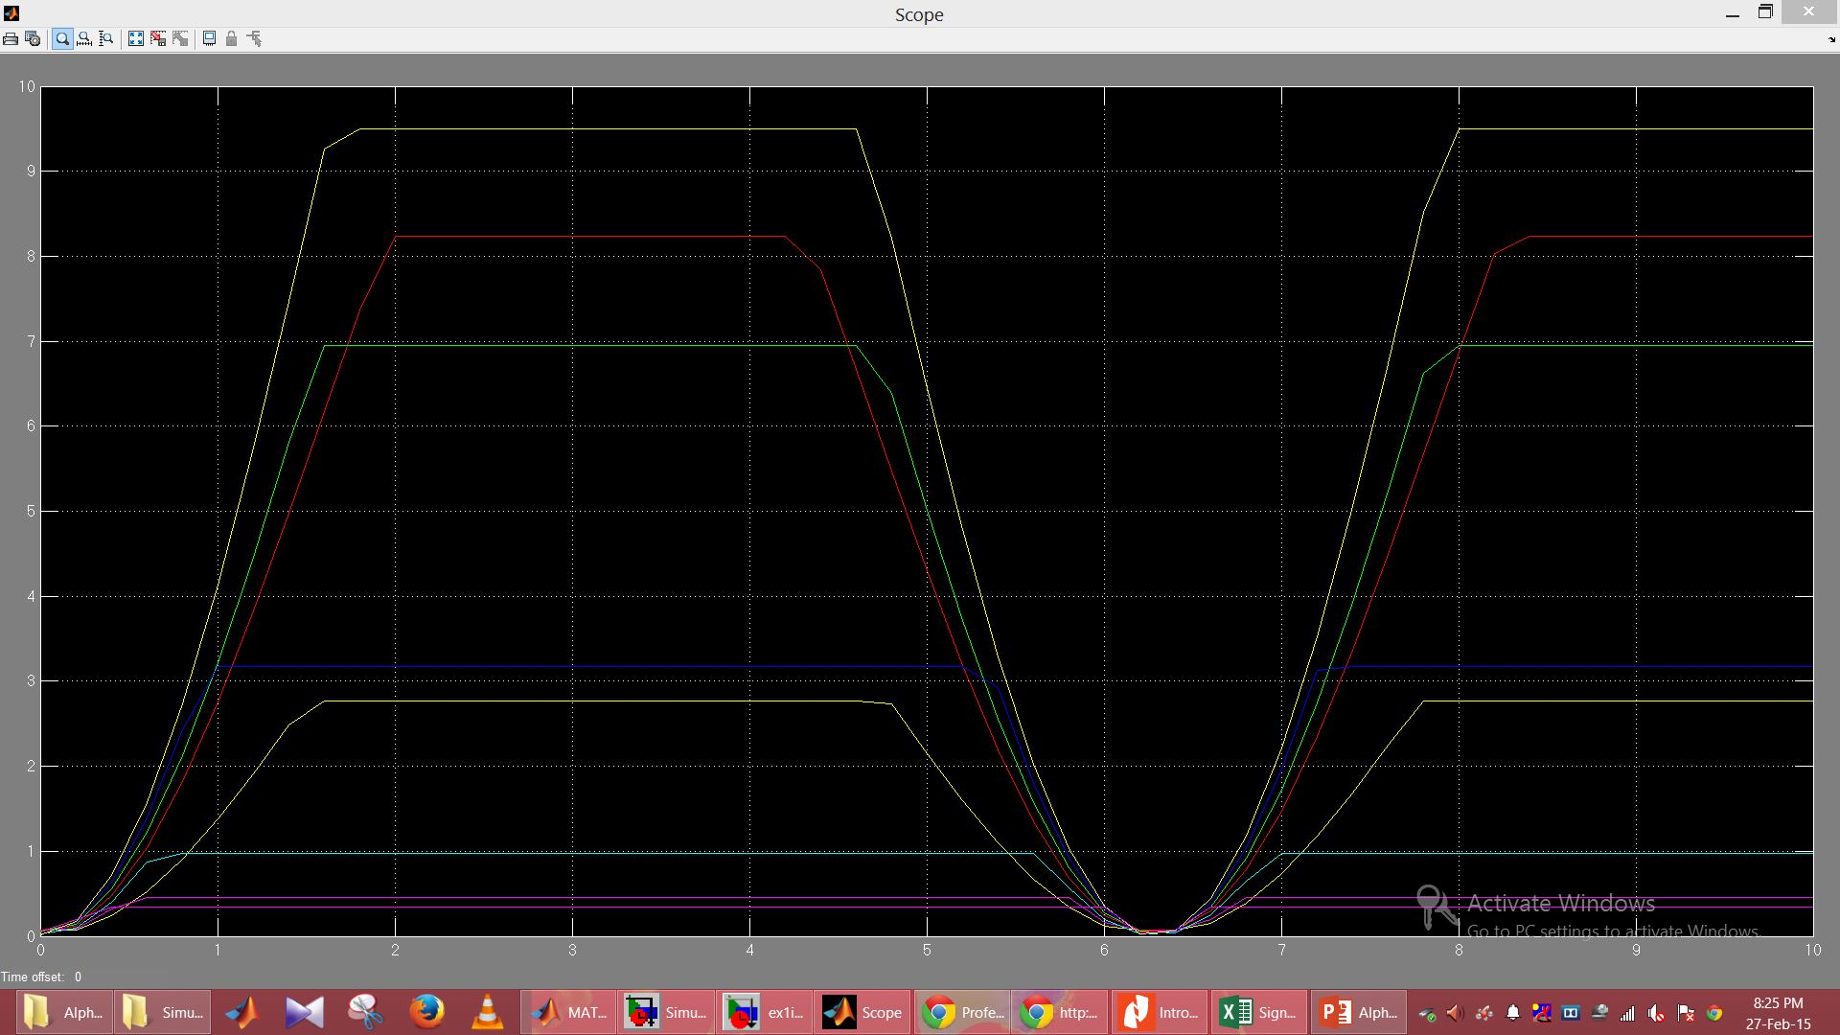
Example :2 - Integrator + Gain block

Slide 36
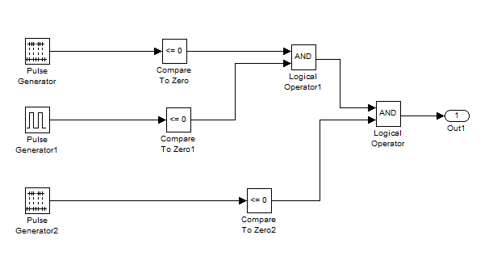
Ex:3 – Modeling Comparisons
y = ((a>0) &&(b>0))||(c>0)

Slide 37
Ex:3 – Modeling Comparisons
What are the properties of random signal generator ?
What is the relation ship between sample period and pulse width?

Slide 38
Q:4
Which of the following blocks can be used to model the equivalent of a generic if-else statement
Logical operator
Switch
Relational operator
Demux
Ans: Switch

Slide 39
Q:5
True or False: The logical operator block only provides the ability to perform the AND operation between two signals
Ans: False

Slide 40
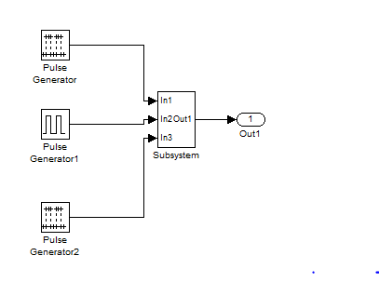
Ex 3: - Creating Subsystems
Scalability – Helps to reduce number of blocks
Readability
From Library browser
From existing blocks

Slide 41
Q:6
Which of the following is an advantage when using subsystems?
Helps reduce the number of blocks displayed in model window
Decreases simulation time
Facilitates grouping of functionally related blocks
Establishes hierarchy in model
Model requires less memory
Ans: A,D

Slide 42
Q:7
The label of an input port on a subsystem matches the name of the corresponding inport blocks within subsystem
Ans: False

Slide 43
Communication systems design
Before starting to build the model, enter
At the matlab command prompt
This sets the Simulink Boolean logic signals parameter to Off
Sets default simulation parameters that are optimal for models
commstartup

Slide 44
Frames and Frame-Based Processing
A frame is a sequence of samples combined into a single vector. By setting Samples per frame to 100 in the Sine Wave block, you set the frame size to 100, so that each frame contains 100 samples. This enables the Vector Scope block to display enough data for a good picture of the sine wave.

Slide 45
Discrete Signals and Sample Times
The Sine Wave block in the Signal Processing Blockset generates a discrete signal.
This means that it updates the signal at integer multiples of a fixed time interval, called the sample time.
You can set the length of this time interval in the Sample time parameter in the block's dialogue.
In the example described in Building a Simple Model, the Sample time has the default value of 1/1000. All the sources in the Communications Blockset and the Signal Processing Blockset generate discrete signals exclusively. These sources are primarily designed for modeling digital communication systems.

Slide 46
Setting Simulation Parameters
If you typed commstartup before creating the model, the Stop time should be set to inf.
The Stop time determines the time at which the simulation ends. Setting Stop time to inf causes the simulation to run indefinitely, until you stop it by selecting Stop from the Simulation menu.
The Stop time is not the actual time it takes to run a simulation.
The actual run-time for a simulation depends on factors such as the model's complexity and your computer's clock speed.
The settings in the Configuration Parameters dialog box affect only the parameters of the current model.

Slide 47
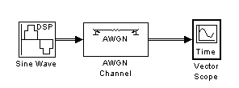
Adding Noise to the Model
You can add noise to the model using the AWGN Channel block, from the Channels library of the Communications Blockset.
The block adds white Gaussian noise to the sine wave. Move the block from the Simulink Library Browser into the model window.

Slide 48
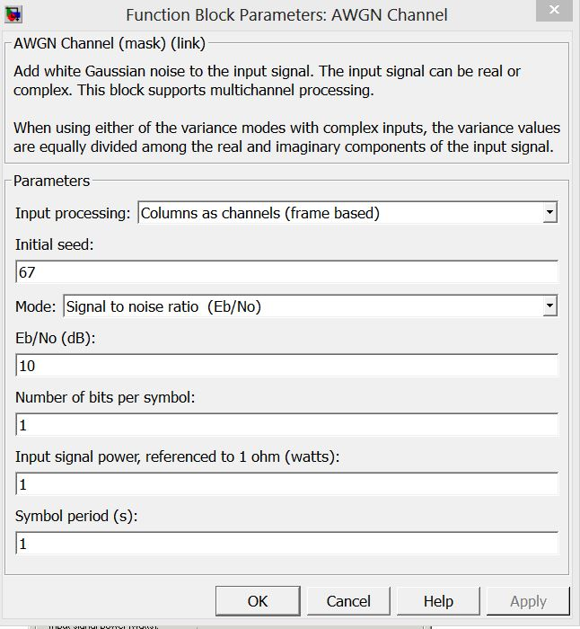
Double-click the AWGN Channel block to open its dialog
Then, click the down arrow in the Mode field and select Signal to noise ratio (SNR).

Slide 49
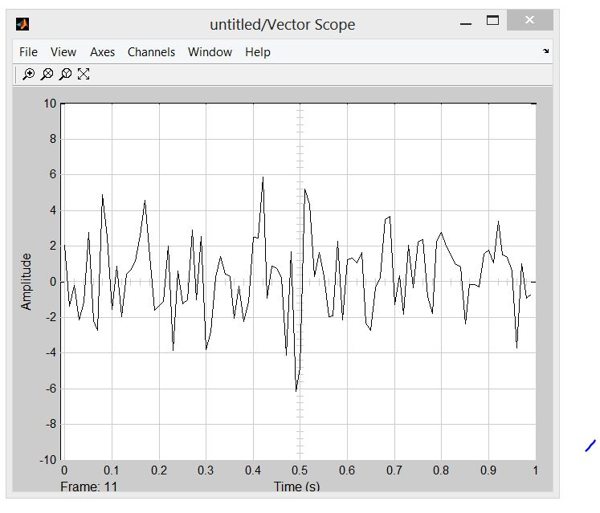
Sinewave with noise affected

Slide 50
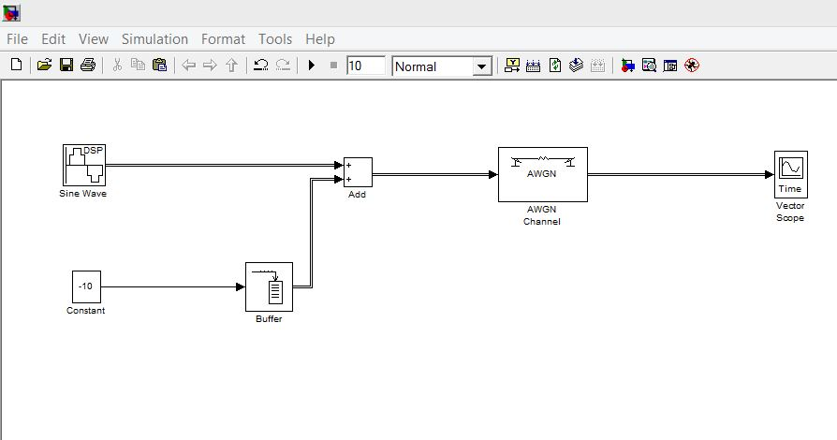
Now try this Model…

Slide 51
Amplitude Modulation
Need Two Signals (Carrier and Message signal)
Carrier – High frequency signal
Message – Low frequency signal

Slide 53
AM - DSB

Slide 54
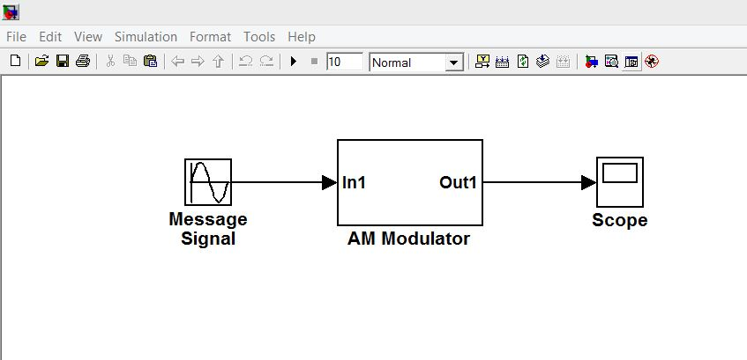
AM with sub systems

Slide 55
Control Systems Design
Usd to model control systems
Model PI,PID, PD controllers
Very much useful for solving multiple order systems
Check the blocks available in control system blockset

Slide 56
Control Systems Design

Slide 57
Control Systems Design - Inter action with MATLAB
How to give values for gain block from MATLAB
Give values of variable from Matlab Command window
Enter K=2.5
Check the variable added in MATLAB workspace

Slide 58
Control Systems Design
How to give values for transfer function ?
Transfer function = num /den
= S+2/S
num=[1 2]
den=[1 0]
What type of solver can be used ?

Slide 59
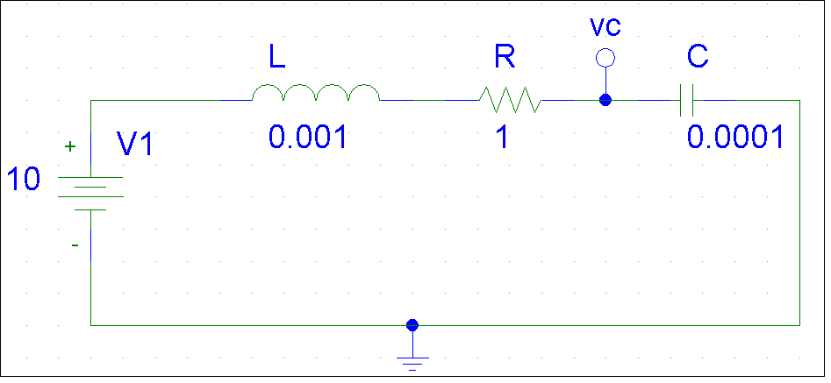
Electrical Circuit Solving
Use Simulink to Solve the Following RLC Circuit

Slide 60
Electrical Circuit Solving

Slide 61
Electrical Circuit Solving
How to flip blocks ?
Right click on block ->format->flip clock
or
Ctrl+Shift+I
Visualize scopes in each step
Solve equation of Circuit
To Replace DC source by AC source i.e., Input sinewave what are the changes to be done ?

Slide 62
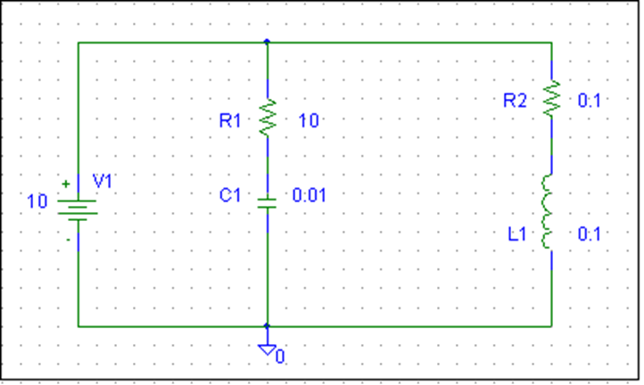
Example -Electrical Circuit Solving
Use Simulink to Solve the Following Circuit

Slide 63
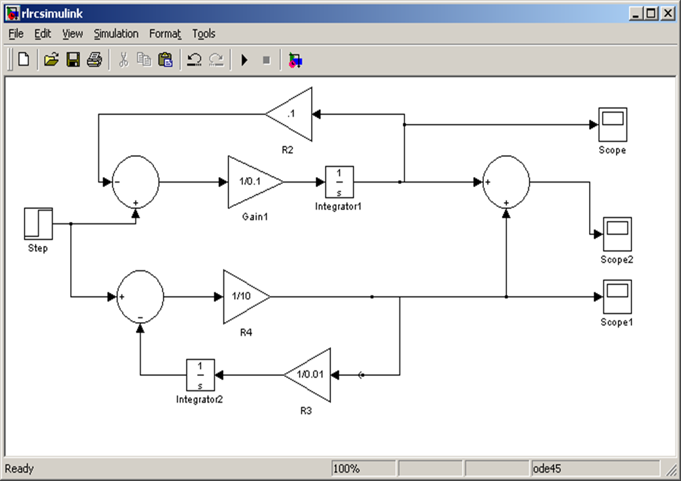
Example - Electrical Circuit Solving

Slide 64
Speech Processing

Slide 65
Speech Processing
How to read a wave file ?
Check for block named from multimedia file
Data Type – Double
Samples per audio channel - 128
Will support avi, Wmv

Slide 66
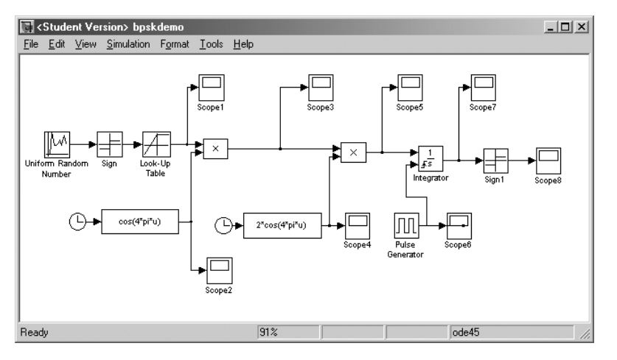
Exercises – Simulink Model for BPSK transmission

Slide 67
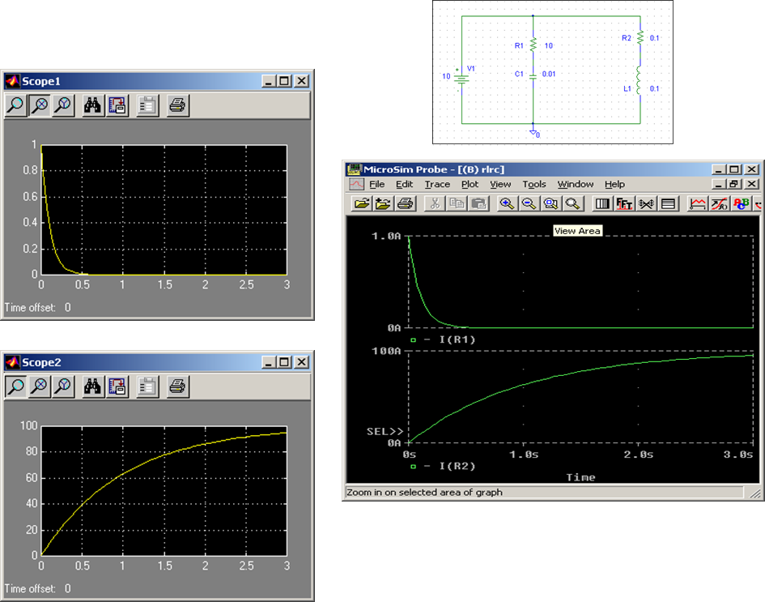
Exercises - Electrical Circuit solving

Slide 68
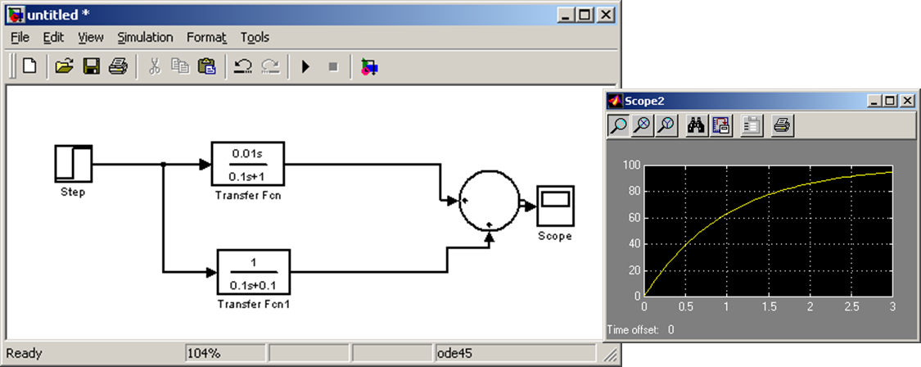
Exercises - Transfer Function

Slide 69
Exercises - Five Band Equalizer

